Slide 1
Cloud SSL-VPN Access Guide
(Internet office user access)

Slide 2
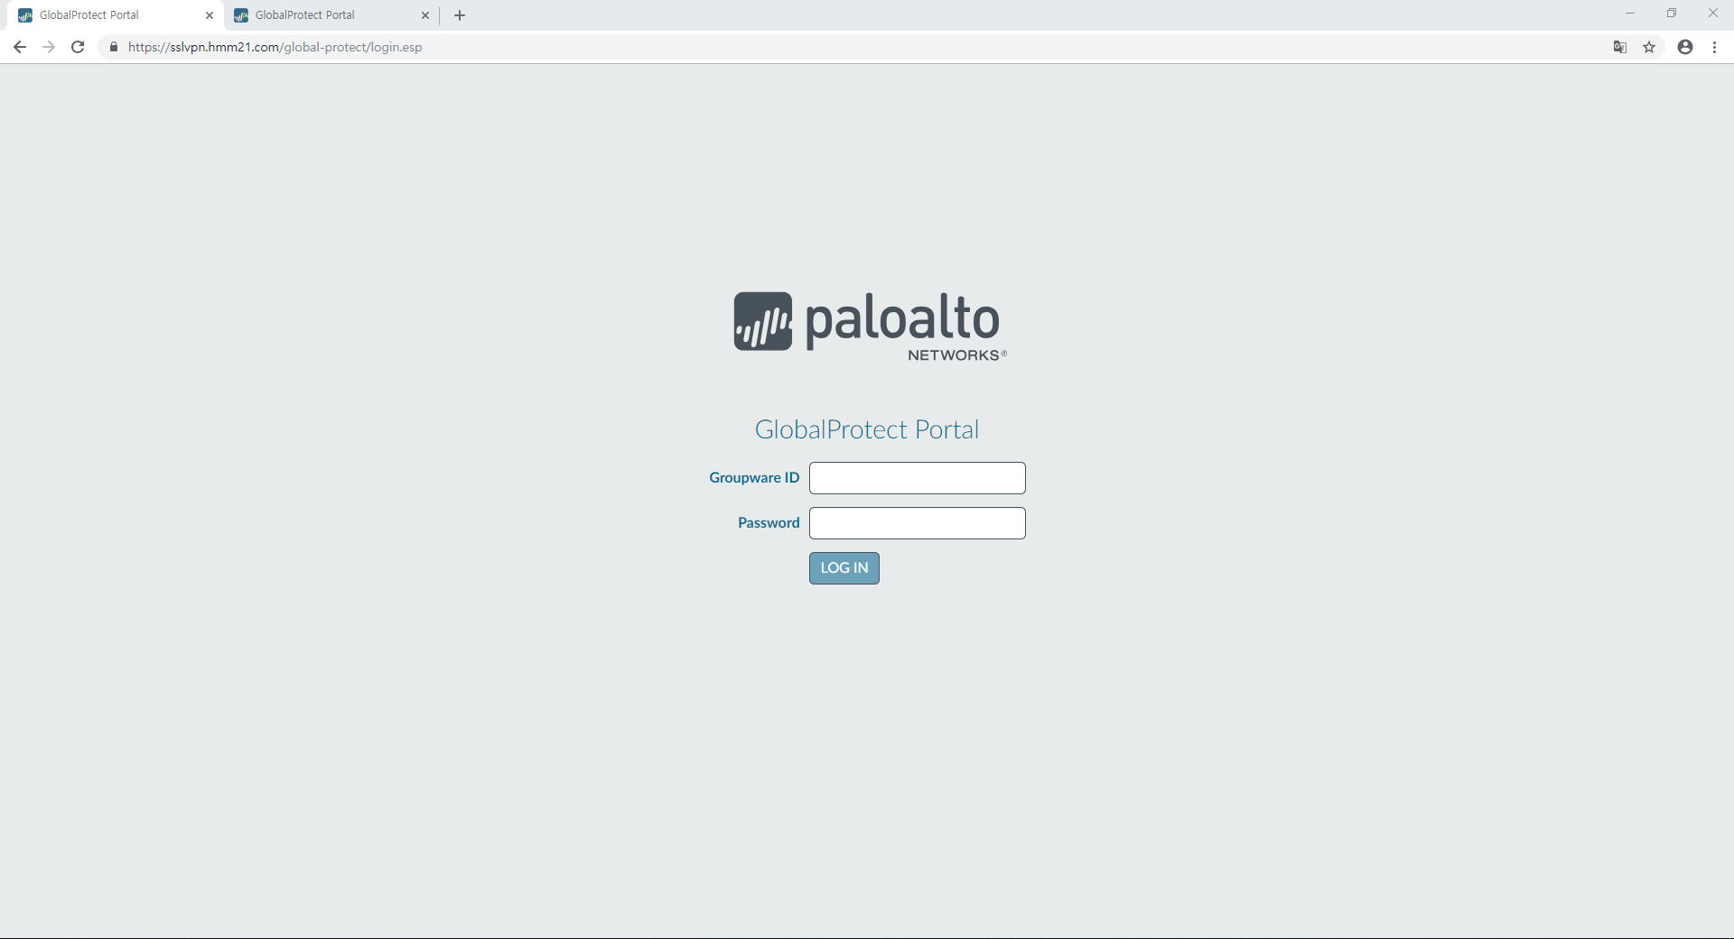
1. SSL-VPN GlobalProtect Agent Installation
SSL-VPN Login Access
- URL : http://sslvpn.hmm21.com
- ID : Groupware Portal ID / PWD : Groupware Portal Password
① Input
- Groupware ID(Portal ID : hmm0000)
- Password(Portal password)
② Click “LOG IN”
1

Slide 3
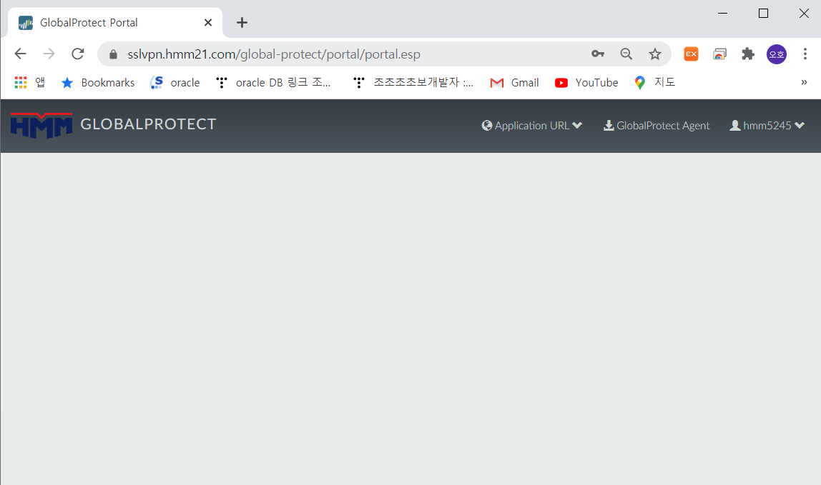
1. SSL-VPN GlobalProtect Agent Installation
You need download the Agent
Click GlobalProtect Agent
2

Slide 4
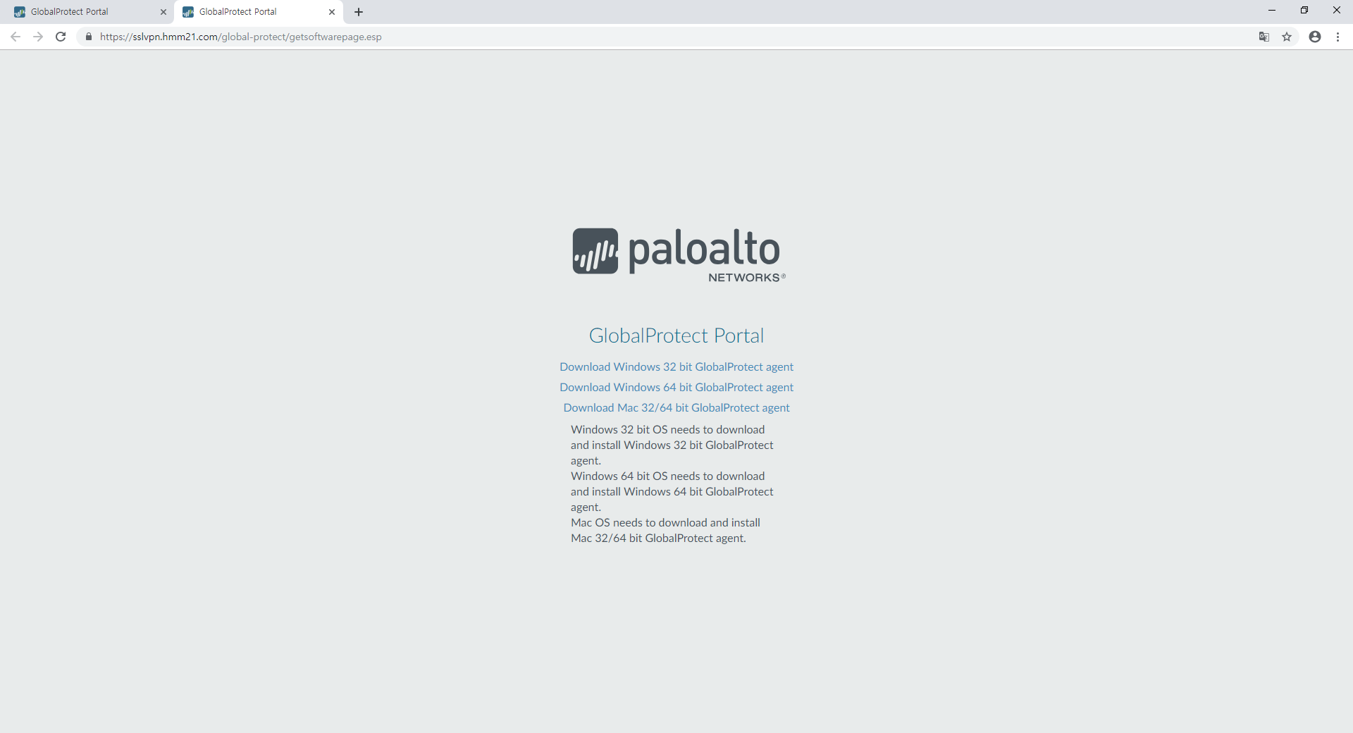
1. SSL-VPN GlobalProtect Agent Installation
Download agent(32 bit or 64bit) for your PC Window bit version
Download Agent for your PC Window bit version
(bit version check : next page reference)
3

Slide 5
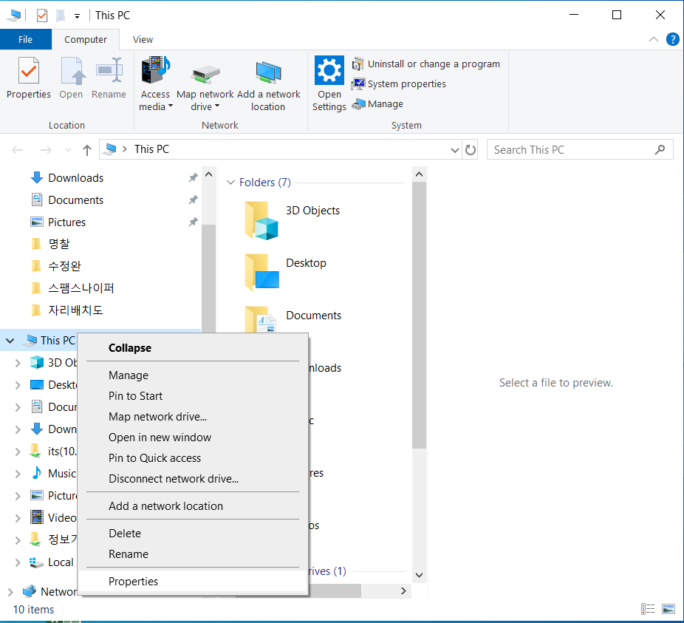
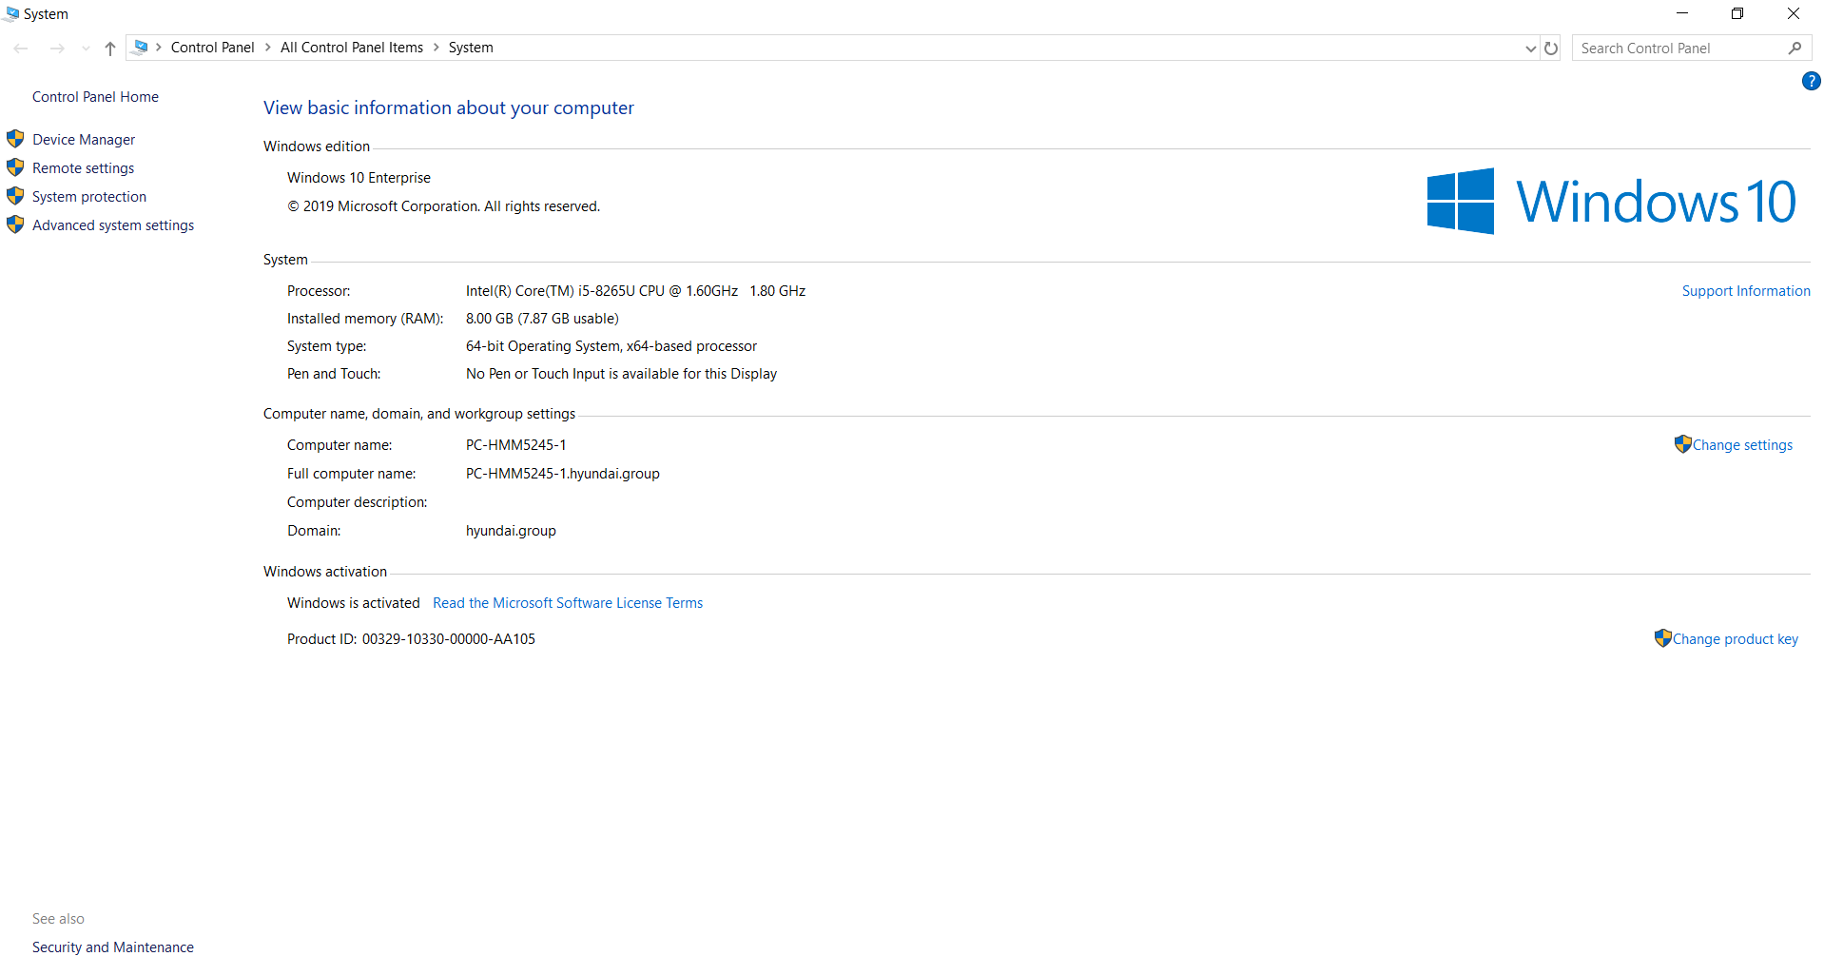
1. SSL-VPN GlobalProtect Agent Installation
check the pc windows bit version(32bit or 64bit)
right click “This PC” and click “Properties”
Check bit window operation system
4

Slide 6
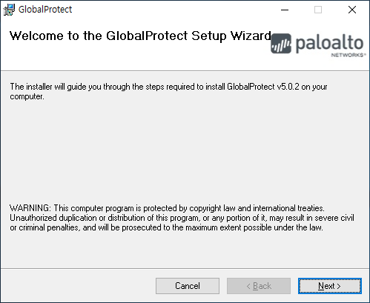
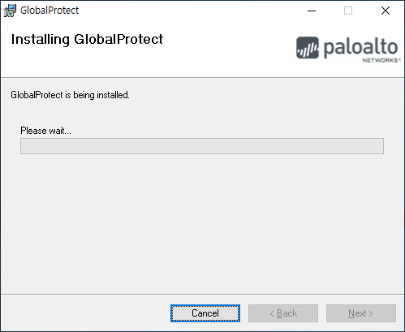
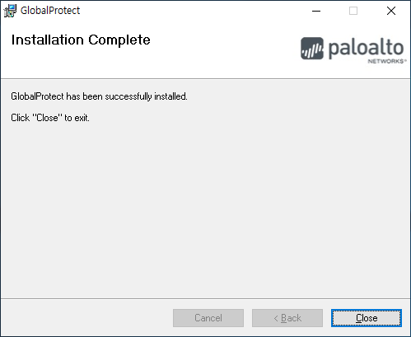
1. SSL-VPN GlobalProtect Agent Installation
Installation Progress
1
Click “Next” Button
2
Installing
3
Finish
(Click “Close” Button)
5

Slide 7
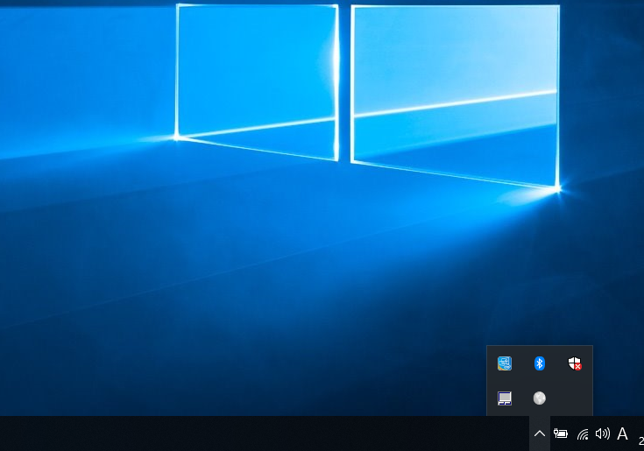
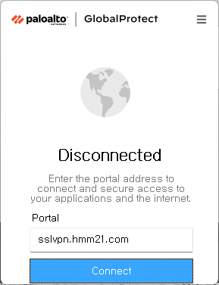
2. Agent Access Method
1) Click the Agent Icon like below image
2) Input “sslvpn.hmm21.com” address url
3) Click “Connect” button
① When Agent is installed, a gray globe-shaped connection agent icon is created on the task bar as below, and clicking the icon displays the connection screen.
② Input : sslvpn.hmm21.com
③ Click : Connect button
6

Slide 8
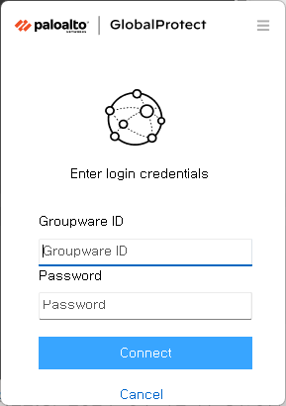
2. Agent Access Method
Log-In : Groupware Portal ID&PWD
- Refer to FAQ 3 if the pop-up window below is not produced
① Input the Groupware ID 및 Password
② Click “Sign In”Button
7

Slide 9
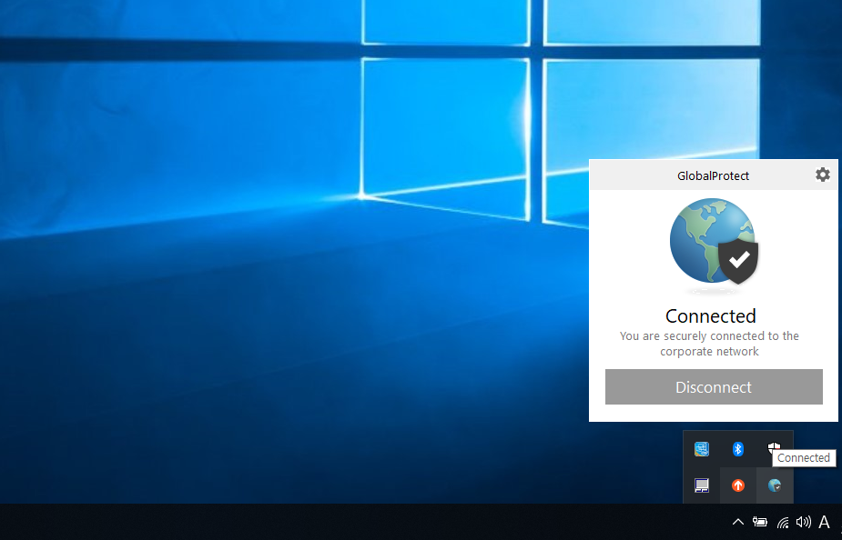
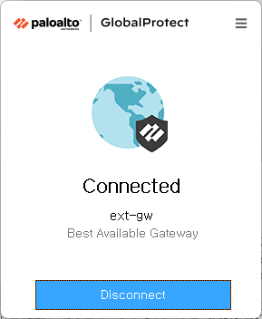

2. Agent Access Method
You can see connecting like below screen.
[Status]
Connected(Log in) / Disconnect(Log out)
When Agent login is complete, the globe icon turns blue in the taskbar and displays as Connect.
After logging, you can access intra system(sbt,sbz….)
8

