Slide 1
Cloud SSL-VPN
Trouble shooting(ENG)

Slide 2
SSL-VPN Troubleshooting
Contents
“Connection Failed” Message(case 1) / “Connecting…”
“Connection Failed” Message(case 2)
“Connection Failed” Message(case 3)
Ran VPN Agent but can’t connect “New GAUS Site” (case 1)
Ran VPN Agent but can’t connect “New GAUS Site” (case 2)
Can’t connect “sslvpn.hmm21.com”
Ran Paloalto VPN Agent but not appear login or address window
Log collection method
Uninstall SSL-VPN Agent

Slide 3
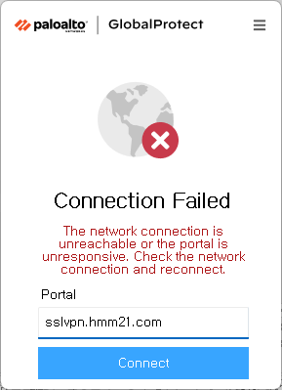
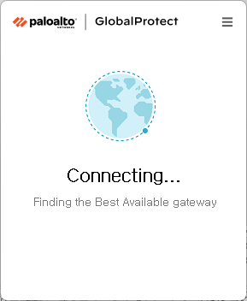
SSL-VPN FAQ 1
Keyword : “Connection Failed” Message(case 1) / “Connecting…”
Problem | Cause | Action
 | VPN Server / Agent unable to communicate normally due to conflicts with Anti-Malware | SSL-VPN Agent should be excluded from Anti-Malware or uninstall that Anti-Malware Path for exception : C:\Program Files\Palo Alto Networks
“Connection Failed” Message
“Connecting…”

Slide 4
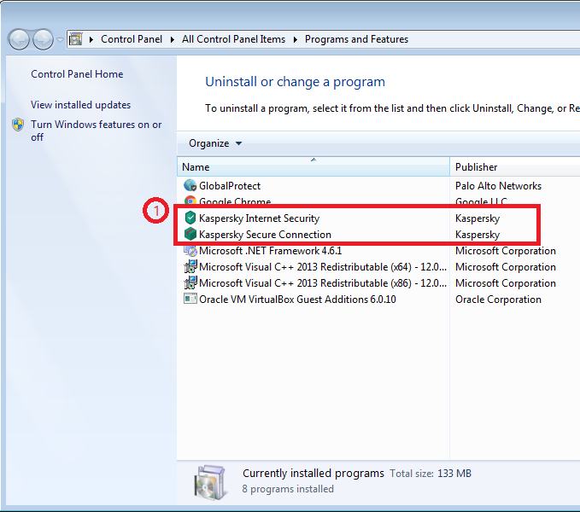
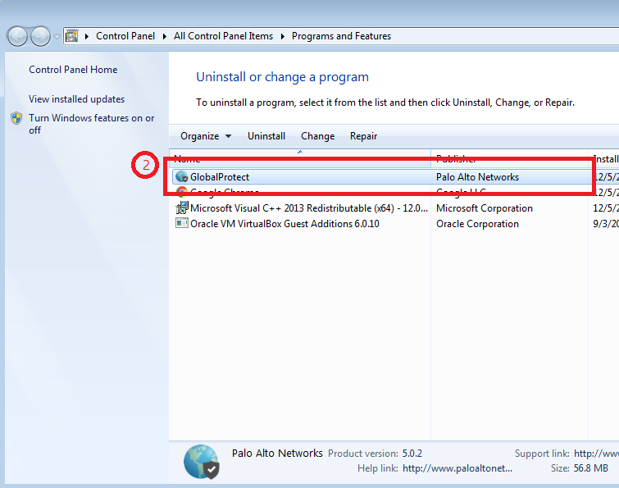
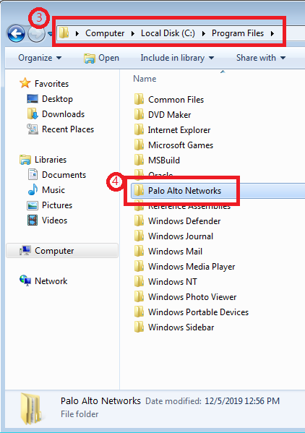
SSL-VPN FAQ 1
Guide : Uninstall Anti-Malware and Paloalto VPN re-install
Conflict case that Anti-Malware with SSL-VPN
1) Anti-malware uninstall in Programs and Features(ex: Kaspersky)
2) “GlobalProtect” uninstall in Programs and Features
3) Delete “Palo Alto Networks” in C:\Program Files
4) Install “SSL-VPN Agent” after the PC restart

Slide 5
SSL-VPN FAQ 2
Keyword : “Connection Failed” Message(case 2)
Problem | Cause | Action
 | Lack of program privileges or Program Execution Error | Run vpn after reboot Run as administrator after the VPN process kill
“Connection Failed” Message

Slide 6
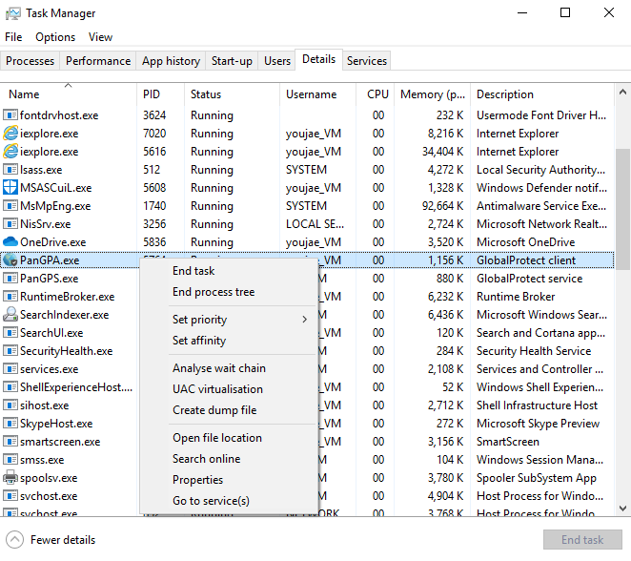
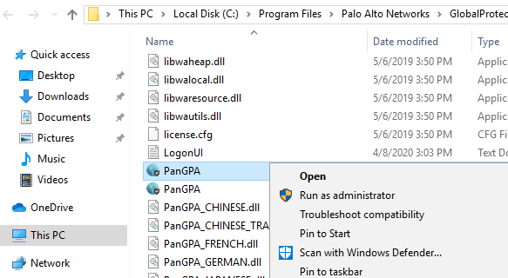
SSL-VPN FAQ 2
Guide : Run as administrator
Task Manager terminates the current process and runs as an administrator
- If the symptoms remain the same after rebooting, follow these steps
1
3
4
5
2
Run with VPN Process Manager privileges
kill VPN process after opening process location

Slide 7
SSL-VPN FAQ 3
Keyword : “Connection Failed” Message(case 3)
Problem | Cause | Action
 | Connection failure due to unstable network | Check network connectivity and clean up unnecessary networks
“Connection Failed” Message

Slide 8

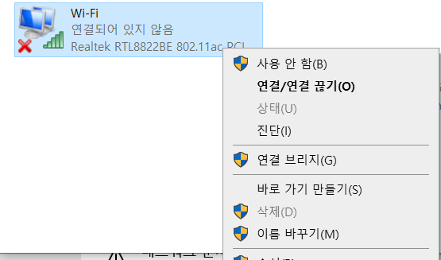
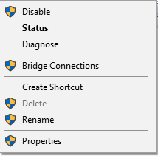
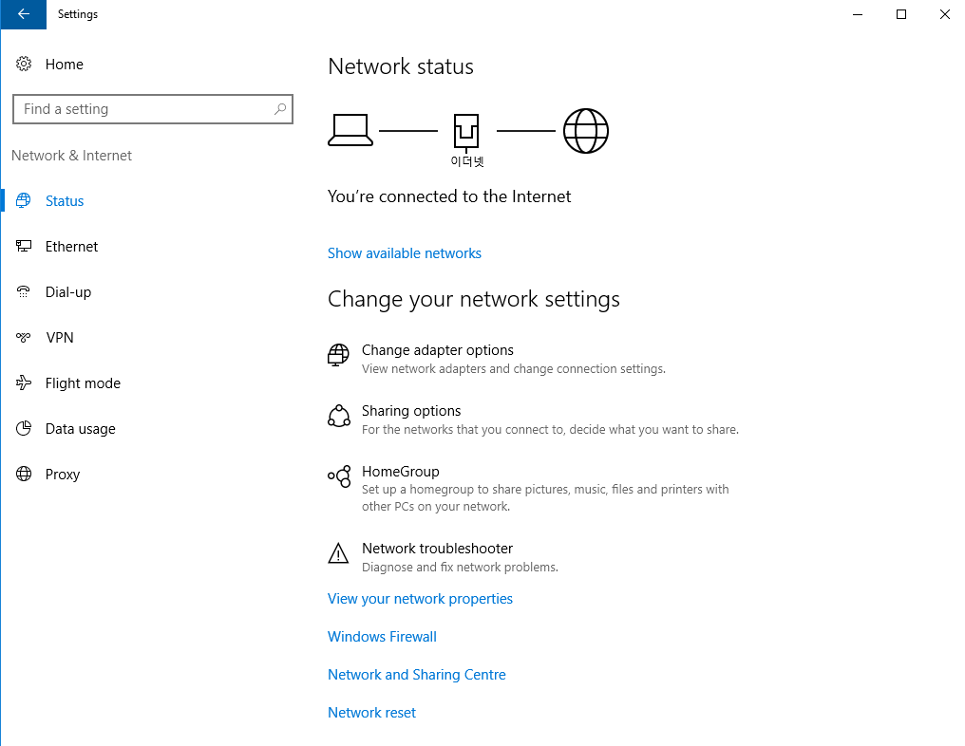

SSL-VPN FAQ 3
Guide : Unnecessary Network Cleanup
Stabilize your environment by cleaning up unnecessary networks (if you use wired networks)
2
4
1
Right click this icon and click “Open Network and Sharing Centre”
Right-click unnecessary network and click "Disable"
3
This interface is Paloalto VPN, so never click "Disable"
Click “Change adapter options”

Slide 9
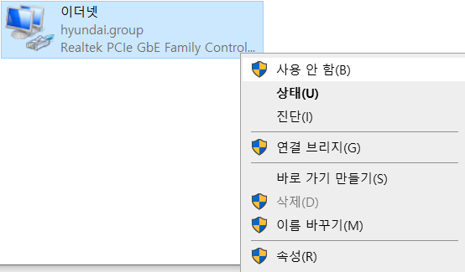
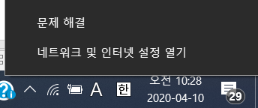
SSL-VPN FAQ 3
Guide : Unnecessary Network Cleanup
Stabilize your environment by cleaning up unnecessary networks (if you use wireless networks)
2
4
1
Right click this icon and click “Open Network and Sharing Centre”
Right-click unnecessary network and click "Disable"
3
This interface is Paloalto VPN, so never click "Disable"
Click “Change adapter options”

Slide 10

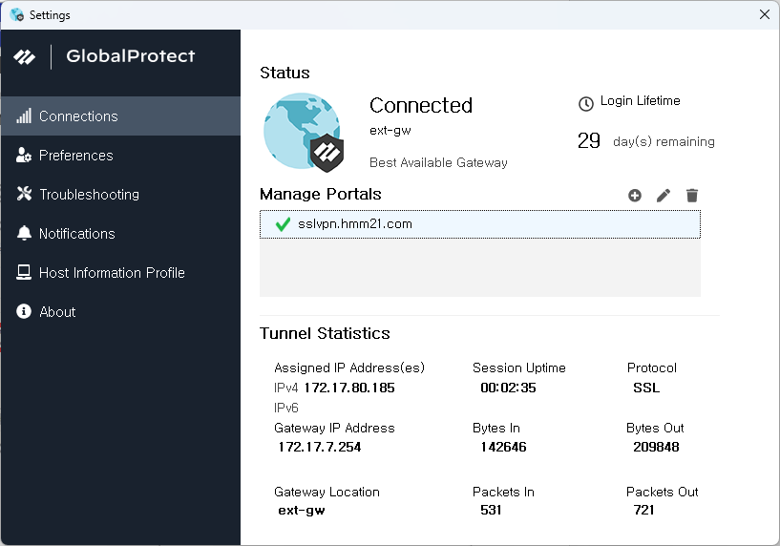
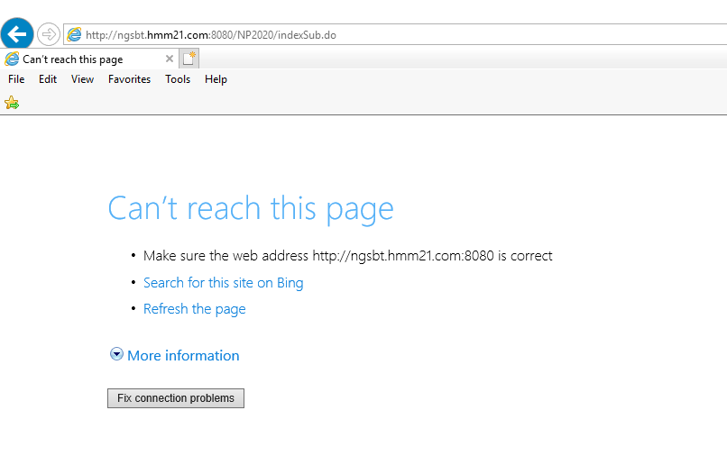
SSL-VPN FAQ 4
Keyword : Ran VPN Agent but can’t connect “New GAUS Site” (case 1)
Problem | Cause | Action
 | Were previously using the SSL-VPN Agent and logged in to a domain other than sslvpn.hmm21.com | Add VPN address of HMM
VPN Agent login success
Logged in to the VPN Agent but
New GAUS not accessible

Slide 11
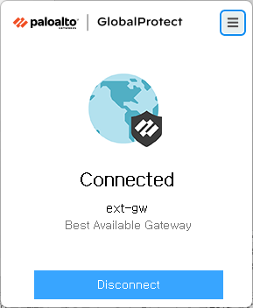
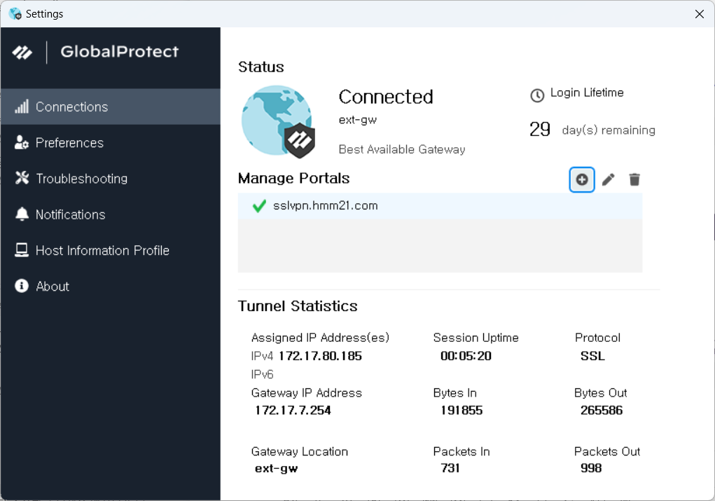
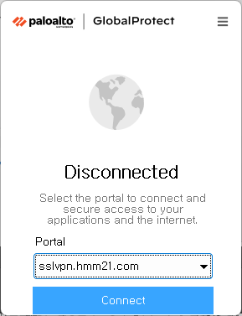

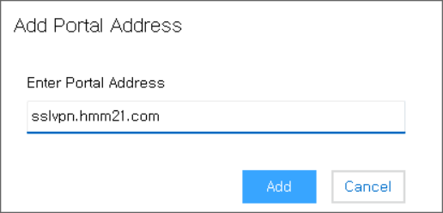
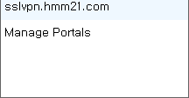
SSL-VPN FAQ 4
Guide : Add VPN address of HMM
Add VPN address of HMM
1) Flowing this process add the Portal address(sslvpn.hmm21.com)
2) Select sslvpn.hmm21.com and login VPN
(If there is only one registered URL, This select box is not appear)
1
2
3
4
5
8
6
7

Slide 12
SSL-VPN FAQ 5
Keyword : Ran VPN Agent but can’t connect “New GAUS Site” (case 2)
Problem | Cause | Action
 | Blocking due to Windows Firewall | Adding permissions to a firewall
VPN Agent login success
Logged in to the VPN Agent but
New GAUS not accessible

Slide 13
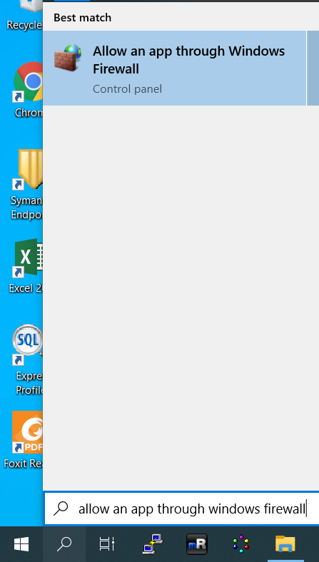
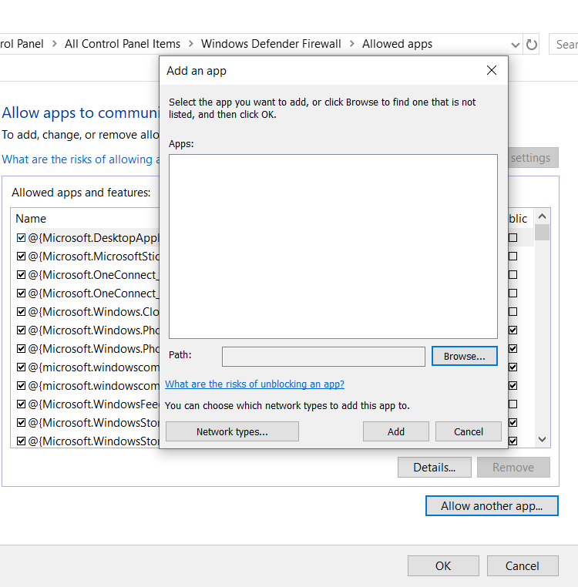
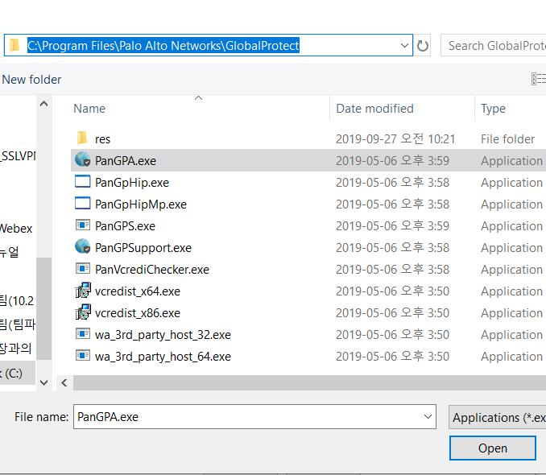
SSL-VPN FAQ 5
Guide : Add permissions to a firewall
Add permissions to a firewall
3
6
7
5
4
8
2
1

Slide 14
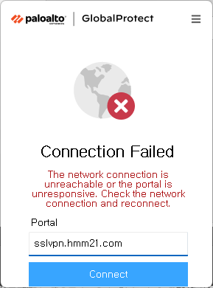
SSL-VPN FAQ 6
Keyword : Can’t connect “sslvpn.hmm21.com”
Problem | Cause | Action
 | Incorrect portal address input | Fix address
Incorrect input(Include spaces)

Slide 15

SSL-VPN FAQ 6
Guide : sslvpn.hmm21.com address modification method
Incorrect input Portal address
- The following message will occur if the Portal address you entered has a problem
- Action : Check portal address and fix it
Error sample(Include spaces)
normal sample

Slide 16
SSL-VPN FAQ 7
Keyword : Ran Paloalto VPN Agent but not appear login or address window
Problem | Cause | Action
Ran Paloalto VPN Agent but not appear login or address window (Paloalto's process is present when checking through taskmanager) | If multiple users are logged in to one PC, and one user has a VPN settings window, the other user will not see it | Use an administrator rights account to end the Palo alto-related process that is being promoted by another user. (However, the operation is carried out with the consent of the user operating the operation.)

Slide 17
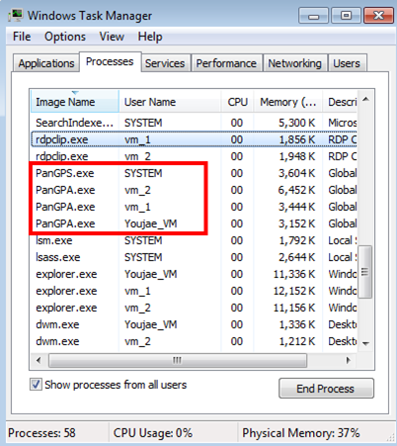
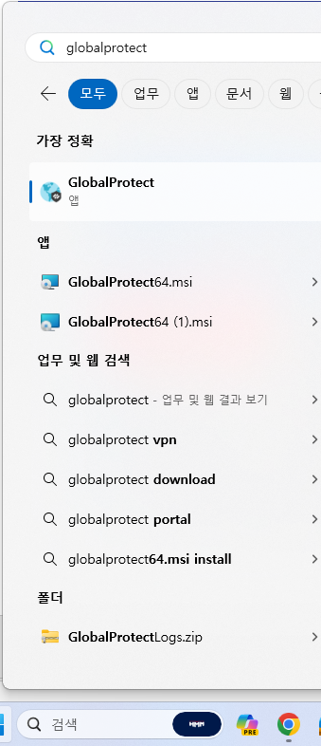
SSL-VPN FAQ 7
Guide :Kill VPN process in use by another user
Log in PC as an administrator and kill the VPN process
- Ran Taskmanager and kill VPN process
2
3
1
Another users using VPN process
Run VPN

Slide 18
SSL-VPN FAQ 8
Keyword : Log collection method
Problem | Cause | Action
Obstacles not listed in previous FAQs | Requires verification through log analysis | Requires verification through log analysis

Slide 19
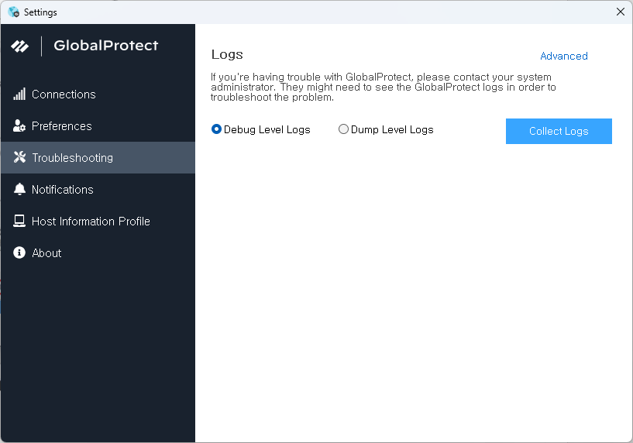
SSL-VPN FAQ 8
Guide : Log collection method
Generate log files in the following order and forward them to the IT Planning Team
1
4
2
3

Slide 20
SSL-VPN FAQ 9
Keyword : Uninstall SSL-VPN Agent
Problem | Cause | Action
If you need uninstall due to abnormal behavior of the Paloalto VPN Agent, see | VPN abnormal behavior of the agent | Manually delete remaining files in the installation path after deleting from Control Panel

Slide 21
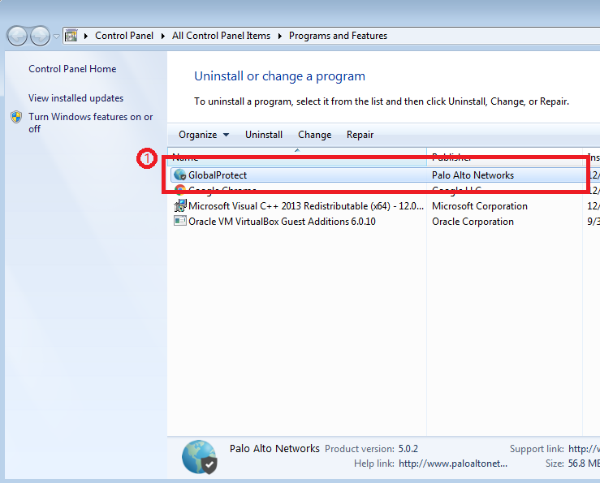

SSL-VPN FAQ 9
Guide : Uninstall SSL-VPN Agent
Uninstall guide
1) GlobalProtect uninstall in Programs and Features
2) Delete “Palo Alto Networks” in C:\Program Files

